Slide 1


National Progressive Donor Survey
Findings From A Survey Of
Progressive Donors
March 2021

Slide 2
Key Findings
Victory Has Its Costs: Some Donors May Cut Back
Though Still Detested, Trump ‘Alone’ Is No Longer The Whole Story
Donors Are More Positive About The Democratic Party & Its Leaders Than In 2017
Donors Are Divided About Strategy, Mirroring Splits Among Party Leaders

Slide 3
Key Findings
The Environment & Trump Remain Top Concerns, But ACA Repeal Has Been Replaced By Covid And Overturning Elections
Donors Want To Hear About Organizational Accomplishments, But Are Even More Focused On Diversity
Donors Still Pick A Lane: Online & Mail Donors Have Different Channel Preferences

Slide 4
Methodology
  2,047 Interviews With Mail And Online Donors To Progressive Organizations
    600 Direct Mail Donors Contacted By Cell, Landlines And Text-to-web
    1,447 Online Donors Via Internet Survey
  Combined Results Weighted To An Even Split Between Mail & Online Donors
  Sample Included Sub-Universes Based On The Source Of List:
    International Aid & Relief Donors
    Civil Rights Issue Donors
    Environmental Issue Donors
    Women’s Issue Donors
    Political Committee Donors
  Interviews Conducted, February 8-14, 2021
  Margin Of Error: 4% For Direct Mail Donors; 2.6% For Online Donors; Higher For Subgroups

Slide 5

CAVEAT: Results For Your Particular Organization May Be Different

Slide 6
Donors Tend To Be Liberal, But Not All Are Strongly So

Slide 7
Mail Donors Are More Liberal, But
Not More Strongly Ideological
Party ID For Mail Donors
Ideology For Mail Donors
Strong Dem
Very Lib
Weak Dem
Smwt Lib
Non-Dem
Moderate
Conservative

Slide 8
Online Donors Have Become Increasingly Partisan, But Less Strongly Ideological
Party ID For Online Donors
Ideology For Online Donors
Strong Dem
Very Lib
Weak Dem
Smwt Lib
Non-Dem
Moderate
Conservative

Slide 9
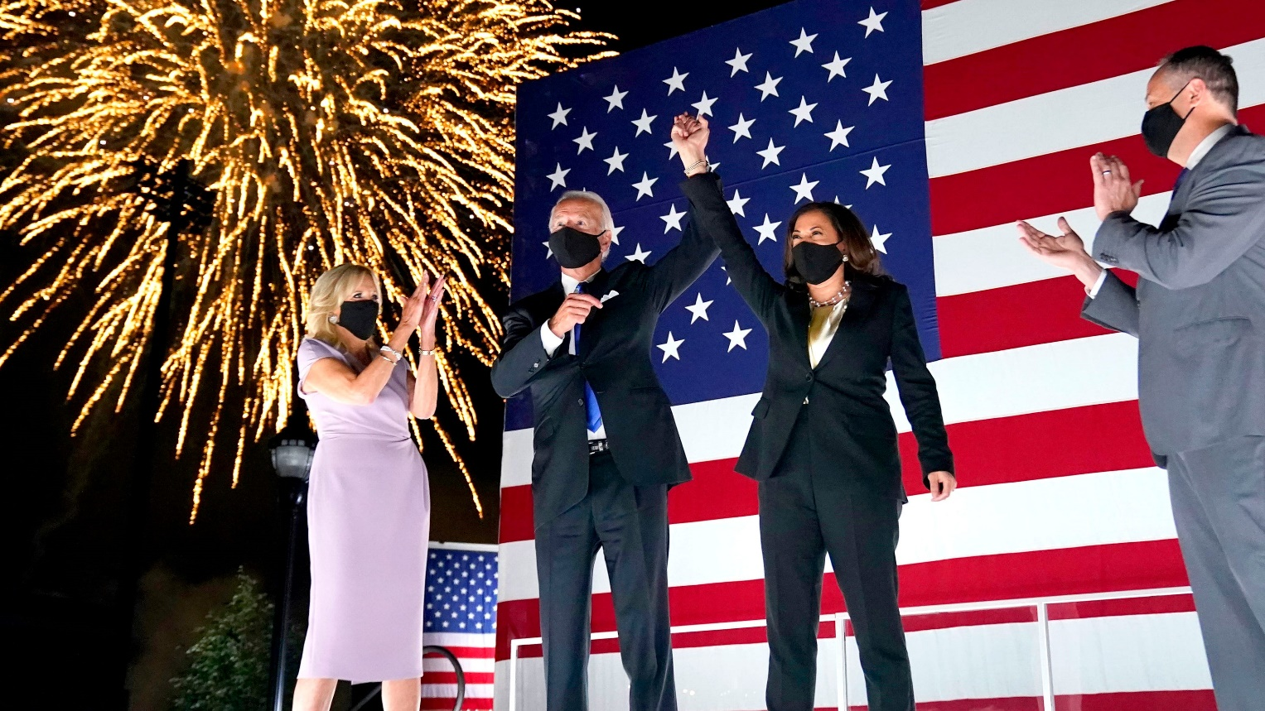
Victory Has Its Costs: Some May Cut Back On Giving

Slide 10
Covid Drove Donations To Health & Social Services Groups, With Many Stretching To Give More
Which comes closest to describing your charitable contributions since the pandemic?
You generally gave to the same organizations but cut back on the amounts
You generally gave to the same organizations as you did in the past
You gave generally the same, shifted to health/social service dealing with the pandemic
You gave more this year, could do more for health/social service dealing with pandemic
MAIL DONORS:
ONLINE DONORS:
45%
32%
Strongly
24%
Strongly
32%
Strongly
22%
Strongly
7%
Strongly
8%
Strongly
7%
Strongly

Slide 11
While Not Large, The Number Planning To Give Less Is At A High & The Number Committed To Increases At A Low
In the next 12 mos., do you plan to increase the amount of your contributions to progressive organizations, decrease the amount of your contributions, or will the amount…. remain about the same?
MAIL DONORS:
ONLINE DONORS:
DK: 12%
DK: 8%
DK: 15%
DK: 30 %
DK: 23%
DK:26%
increase
decrease
stay same

Slide 12
The Number Planning To Increase The Range Of Their Giving Declined Sharply
Which … do you think you will do with your contributions to progressive organizations this year?
Contribute to a smaller number of organizations than I have in the recent past.
Contribute to the same organizations I have in the recent past.
Contribute to a larger number of organizations than I have in the recent past.
MAIL DONORS:
ONLINE DONORS:
2017=Lighter; 2021= Darker
+2
-11
+7
-19

Slide 13
The Intention To Cut Back On Candidate & Party Giving Is Meaningfully Greater Than In The Past
In the next twelve months, do you plan to increase the amount of your contributions to political candidates and political parties, decrease the amount of your contributions, or will the amount of your contribution remain about the same?
MAIL DONORS:
ONLINE DONORS:
Same/More
67%
68%
50%
increase
decrease
stay same

Slide 14
Less Than A Third Felt The Financial Impact Of The Pandemic
How much, if at all, did the pandemic hurt your own personal financial situation?
MAIL DONORS:
ONLINE DONORS:
49%
Not Much At All
42%
Not Much At All
11%
Great Deal
5% Great Deal

Slide 15
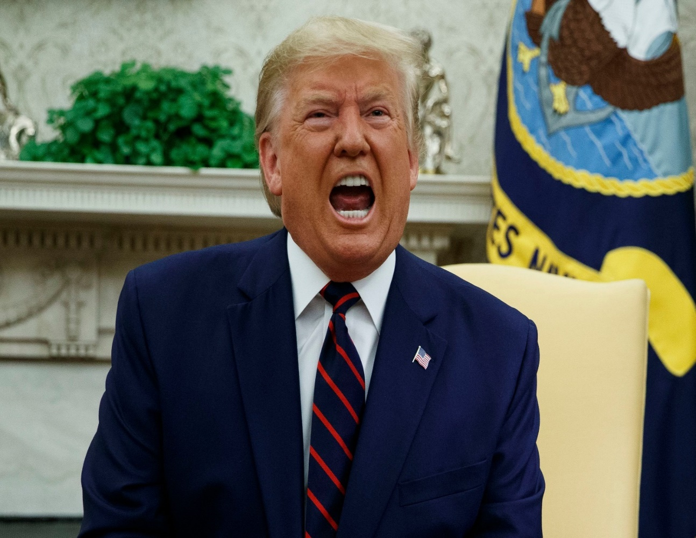
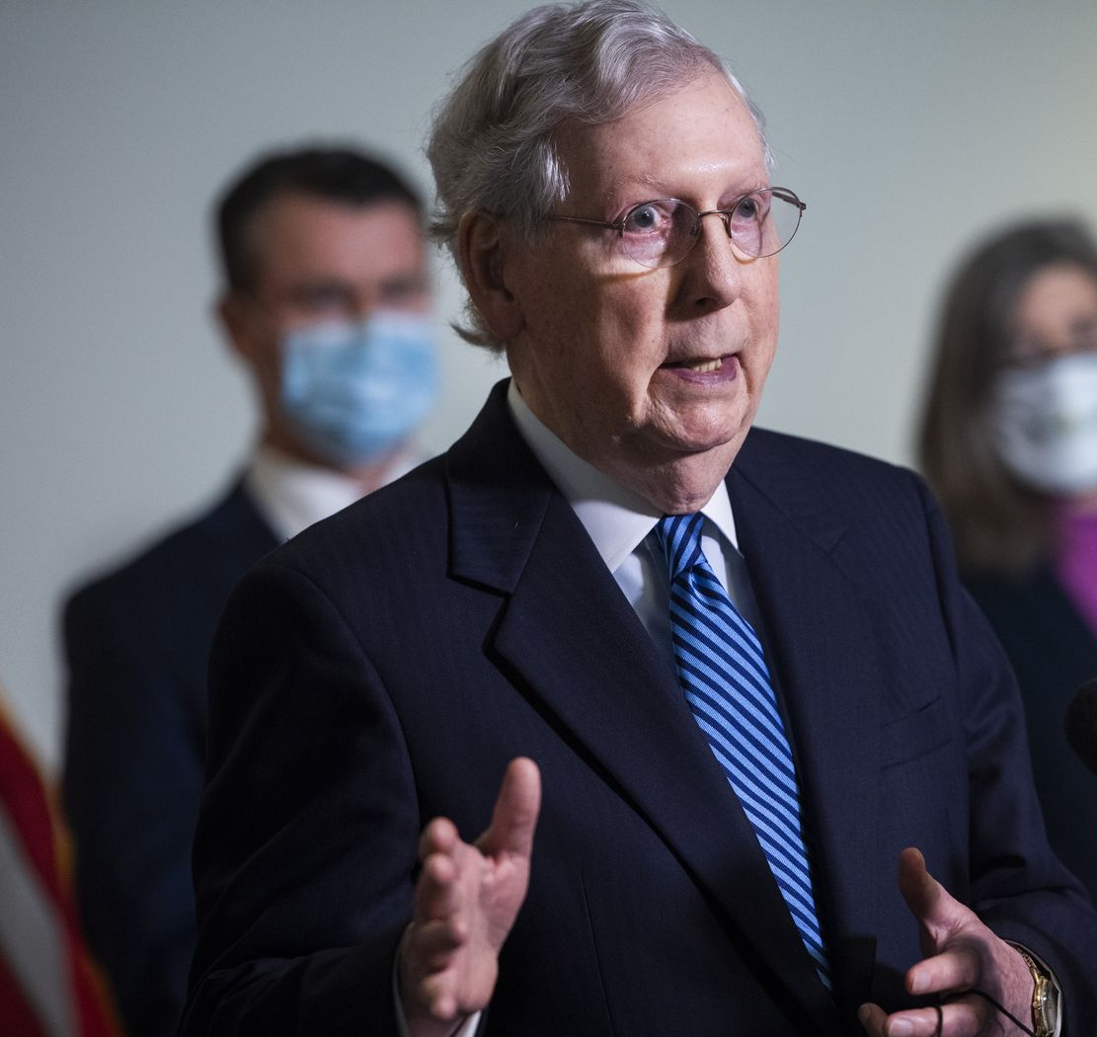
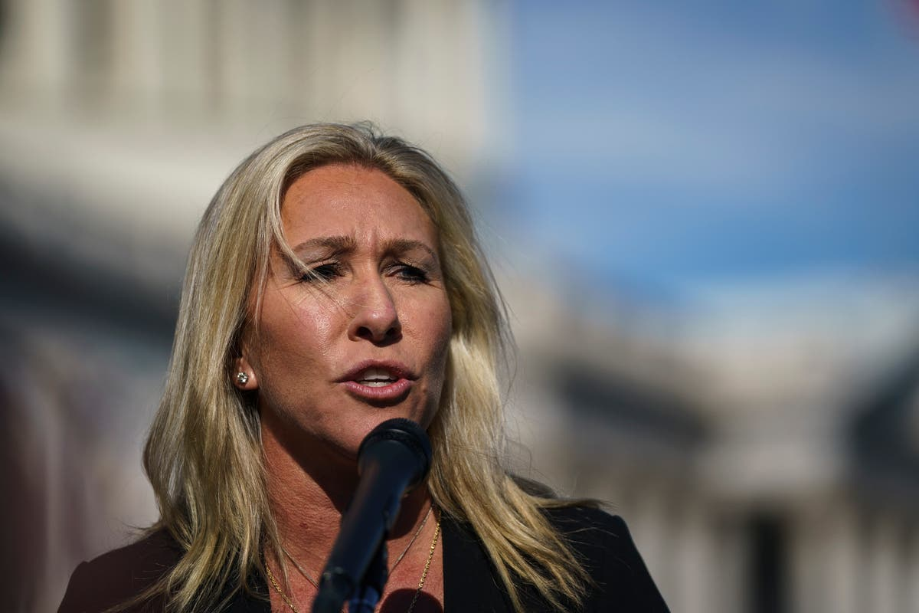
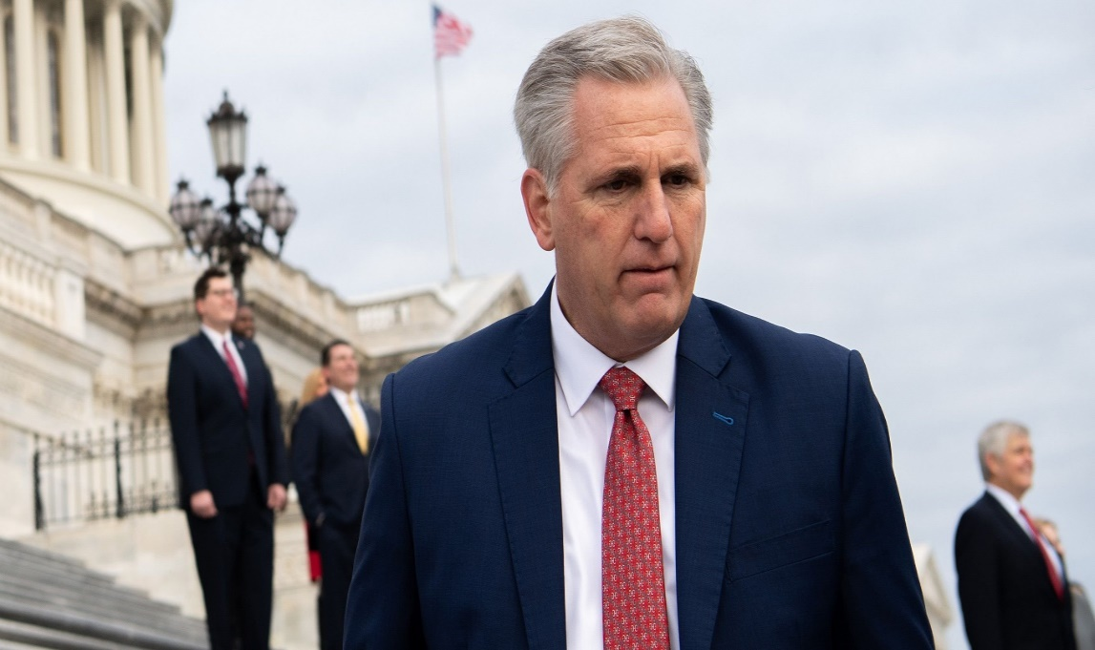
Though Still Detested, Trump ‘Alone’ Is Not The Whole Story

Slide 16
Trump, Don Jr, & MTG Generate The Most Antipathy
Marjorie Taylor Greene Is Already As Well Known As The Trumps & Lindsey Graham
Favorability (rank ordered by mean)
Mean
Hard ID
Ivanka Trump
1.25 | 96%
1.18 | 95%
1.09 | 97%
1.10 | 100%
1.09 | 94%
Lindsey Graham
Donald Trump, Jr.
Donald Trump
Marjorie Taylor Greene

Slide 17
Last Cycle, Trump Provided A Central Reason For Giving, Without Him In Office Some Are Rethinking Donations
Some Plan To Give More, Some Less
When you decided whether or not to contribute to progressive organizations over the last two years, how important was Trump as a reason for you to give?
With Trump out of office, are you more or less likely to donate to progressive organizations over the next two years?
41%
One of the Most
14%
Strongly

Slide 18
The Threat Is Now From Trump & His Congressional Backers
Which comes closer to your point of view about who is the biggest threat to the progressive agenda?
Trump may not be in office, but he is the biggest threat we face
The biggest threats are Congressional leaders in office, like McConnell & McCarthy
Trump & Congressional Republicans are equal threats
43%
Strongly
24%
Strongly
12% Strongly

Slide 19
Donors Are More Positive About The Democratic Party & Its Leaders

Slide 20
The Democratic Party Enjoys A Stronger Image Than In Previous Years
Democratic Party Favorability
Direct Mail Donors
Democratic Party Favorability
Online Donors
% Very Favorable
% Very Favorable

Slide 21
Abrams, Obama, Biden And Harris
Are The Most Popular Democrats
Favorability (rank ordered by mean)
Mean
Hard ID
Stacey Abrams
very favorable 76%
3.79 | 90%
3.75 | 100%
3.71 | 100%
3.68 | 99%
3.56 | 99%
3.44 | 99%
3.39 | 99%
3.33 | 95%
3.30 | 96%
Barack Obama
very favorable 82%
Joe Biden
very favorable 78%
Kamala Harris
very favorable 75%
Elizabeth Warren
very favorable 64%
Nancy Pelosi
very favorable 58%
Bernie Sanders
very favorable 48%
Alexandria Ocasio Cortez
very favorable 44%
very favorable 42%
Chuck Schumer

Slide 22
“Progressive Groups” Have Become As Popular Among Mail Donors As “Liberal Groups”
Direct Mail Donors
Online Donors
% Favorable
% Favorable
Progressive
Liberal

Slide 23
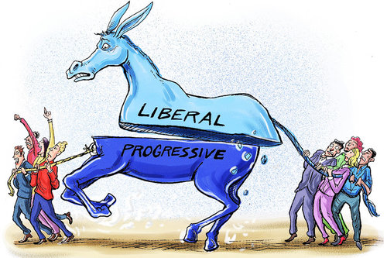
  Donors Are Divided About Strategy
Centrist
Progressive

Slide 24
A Slight Majority Want To Stand Our Ground, While A Large Minority Counsel Caution
Which comes closer to your point of view?
We have to stop being afraid and backing down when Republicans say we are socialists or want to defund the police. To win we need to stand our ground and fight for what we believe.
We have to stop letting ourselves be defined by socialism or defunding the police. If we want to win elections to make progressive gains, we have to be careful about being seen as moving too far left.
 | Fight | Careful
Mail Donor | 55% | 36%
Online Donor | 46% | 47%
Strong Dem | 52% | 41%
Lean Dem | 50% | 43%
Non-Dem | 44% | 42%
Men | 48% | 45%
Women | 53% | 39%
Non-college | 59% | 32%
College + | 49% | 44%
White | 50% | 43%
Non-white | 64% | 30%
42%
Strongly
29%
Strongly

Slide 25
There Is Division Over Fighting For Big Change Without Compromise Vs. Incrementalist Compromise
Specific Examples Push Donors To Compromise
Which is closer to your point of view?
We must fight for big, bold, fundamental change without compromise, because that’s what the country needs and what Democrats got elected to do
OR
To get things done with narrow majorities, threats of filibusters, and conservative Democrats, we must build coalitions, and work across party lines to keep making progress on our priorities
We must fight for big, bold, fundamental change–like Medicare For All and the Green New Deal—without compromise because that’s what the country needs and what Democrats got elected to do
OR
To get things done with narrow majorities, threats of filibusters, and conservative Democrats, we must build coalitions, and work across party lines to keep making progress on priorities such as expanding and improving Obamacare and strengthening environmental regulations.
-3
-14
36%
Strongly
33%
Strongly
40%
Strongly
32%
Strongly
Split Sample in Italics

Slide 26
A Majority Of Young & Non-White Donors Want To Fight For Bold Change Without Compromise
There’s No Difference Between Mail & Online Donors
Which is closer to your point of view? (Splits Combined)
We must fight for big, bold, fundamental change (like Medicare For All and the Green New Deal—) without compromise because that’s what the country needs and what Democrats got elected to do
OR
To get things done with narrow majorities, threats of filibusters, and conservative Democrats, we must build coalitions, and work across party lines to keep making progress on priorities (such as expanding and improving Obamacare and strengthening environmental regulations).
 | Bold | Incremental
Mail Donor | 43% | 51%
Online Donor | 42% | 52%
Strong Dem | 45% | 49%
Lean Dem | 40% | 54%
Non-Dem | 30% | 57%
<60 | 58% | 34%
60+ | 40% | 54%
Non-college | 39% | 53%
College + | 43% | 51%
White | 42% | 51%
Non-white | 57% | 41%
-9
34%
Strongly
36%
Strongly

Slide 27
Donors Are Somewhat More Likely To Give For Policy Fights Than Campaigns – Unless It’s To Defeat Trumpers
With Trump Added, Few Are Undecided And Most Online Donors Prioritize Campaigns
Over the next two years, are you more likely to give to organizations that fight for good legislation and policy OR organizations that fight to help good candidates win elections?
Over the next two years, are you more likely to give to organizations that fight for good legislation and policy OR organizations that fight to help good candidates win elections and defeat Trump supporters ?
 | Policy | Elections | Don’t Know
Mail | 46% | 33% | 21%
Online | 38% | 37% | 25%
 | Policy | Elections | Don’t Know
Mail | 46% | 43% | 11%
Online | 37% | 51% | 12%
30%
Strongly
23%
Strongly
33%
Strongly
38%
Strongly

Slide 28
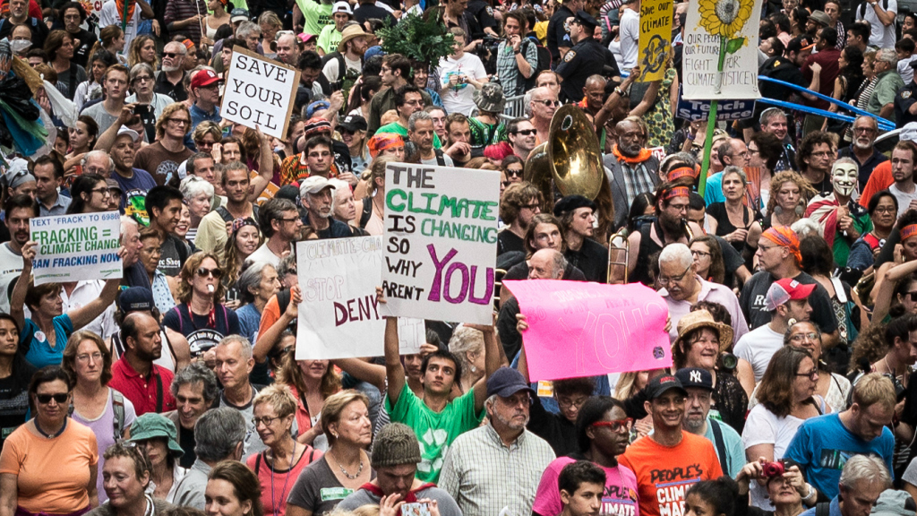
The Environment & Trump Remain Top Concerns, But ACA Repeal Has Been Replaced By COVID & Overturning Elections

Slide 29
Environmental Concerns Top The Agenda, Followed By Attacks On Democracy & Trump
COVID & Gerrymandering Are Also Salient
Global warming threatens our children and grandchildren
We are not doing enough to protect our environment
Attacks on the election results/electoral system are undermining democracy
% worries one of most
1st Tier
Trump and his supporters still have too much influence
The pandemic continues to be a dire health threat to this country and the world
Reps are using gerrymandering to unfairly hold onto power
Attacks on expanded early vote and vote by mail laws undermine democracy
The pandemic made hunger, homelessness & poverty worse
Reps. trying to take health ins. away from millions of people
COVID-19 issues
Civil rights issues
Big corps are getting away w/polluting our environment
Environmental issues
Trump & far-right
The far-right wing has too much influence
Gender Equality issues
Election/Representation
Anti-vax & anti-mask fears are threatening our response to COVID
Health care
Split Samples in Italics
Misc./More than one

Slide 30
Climate Change Is Increasing In Salience, While Corporate Polluters Declines
% Worries The Most Over Time

Slide 31
Concern About ACA Repeal Declined
% Worries The Most Over Time

Slide 32
Causes Generating Less Concern Include
Social Issues, Immigration And Police Reform
The NRA and other extremists are blocking common sense gun safety laws
Too little has been done to eliminate systemic racism
% worries one of most
2nd Tier
Minority communities are suffering from unjust policing
Trump’s supreme court justices may make abortion illegal
Special interest lobbyists have too much power
The right to choose an abortion may be taken away
Social security and Medicare are at risk
Republicans are trying to repeal the Affordable Care Act
Laws guaranteeing women’s rights/equality in workplace are being threatened
The dismantling of protections for refugees & immigrants has hurt our country
COVID issues
Congressional rules and procedures like the filibuster are being abused
Civil rights issues
Environmental issues
Republicans want to make gay marriage illegal again
Gender equality issues
Corruption/Gov’t
Civil rights protections for LGBTQ citizens are being threatened
Health care
Our police need major reform
Misc./More than one
Split Samples in Italics

Slide 33
With Democrats In Control, Concern About Abortion Rights Fell To 2007 Levels
MAIL DONORS:
The right to choose an abortion may be taken away
ONLINE DONORS:
The right to choose an abortion may be taken away
Worries the most

Slide 34
Online Donors Express More Concern About The Environment Than Mail Donors
Top Concerns by Donor Type
% worries the most | Mail | Online | Difference
We are not doing enough to protect our environment | 47% | 62% | -15
Global warming threatens our children and grandchildren | 53% | 68% | -14
Attacks on the elections results and the electoral system are undermining our democracy | 46% | 60% | -14
The far right-wing has too much influence | 30% | 42% | -13
Republicans are using gerrymandering to unfairly redraw congressional districts to hold onto power | 43% | 53% | -10
The dismantling of protections for refugees and immigrants has hurt our country, as well as the lives of too many families | 25% | 17% | +8
Trump and his supporters still have too much influence | 45% | 53% | -8
Republicans are trying to repeal the Affordable Care Act | 32% | 23% | +9

Slide 35
Attacks On Electoral Results & The System Elicit More Concern Than Attacks On Mail Or Early Vote
Split Language | % Worries Most | Mean Concerning (5-1 scale)
Attacks on the election results and the electoral system are undermining our democracy. | 53% | 4.33
Attacks on expanded early vote and vote by mail laws are undermining our democracy. | 44% | 4.14

Slide 36
Trump & His Supporters Are A Bigger Concern Than The Far Right Alone
Split Language | % Worries Most | Mean Concerning (5-1 scale)
Trump and his supporters still have too much influence | 49% | 4.27
The far right-wing has too much influence | 36% | 4.09

Slide 37
Republicans Taking Away Health Care Hits Home Much More Than Repealing The ACA
Split Language | % Worries Most | Mean Concerning (5-1 scale)
Republicans are trying to take health insurance away from millions of people and remove protections for pre-existing conditions. | 43% | 4.24
Republicans are trying to repeal the Affordable Care Act. | 29% | 3.85

Slide 38
Unjust Policing In Minority Communities Is A Bigger Concern Than Police Reform
Split Language | % Worries Most | Mean Concerning (5-1 scale)
Minority communities are suffering from unjust policing | 30% | 4.07
Our police need major reform | 15% | 3.72

Slide 39

Donors Want To Hear About Accomplishments, But Are Even More Focused On Diversity

Slide 40
Few Know A Great Deal About Where Their Money Goes, With Mail Donors Slightly More Informed
Similar To 2017 Over One In Four Say They Do Not Know Much About It
When you think about the money you contribute to progressive organizations, do you feel as though you know a great deal about where your money goes, something about where your money goes, not too much, or not much at all about where your money goes?
MAIL DONORS:
ONLINE DONORS:
2017: 21%
2017: 31%
22%
Great Deal
9%
Not Much
At All
15%
Great Deal
20%
Not Much At All

Slide 41
Donors Want To Hear About Diversity, As Well As Accomplishments & Spending
How important is it for progressive or political organizations to do each?
Mean Score
% absolutely essential (dark green), very important (light green)
3.12
3.08
3.03
2.87
1.98
Show a commitment to diversity and inclusiveness
Show specific accomplishments
Explain exactly how your money is being spent
Provide news and updates on the cause
Use Twitter/social media engage activists and promote cause

Slide 42
Explaining How Money Is Being Spent
Is More Important To Smaller Donors
Diversity Is At The Top Across Other Giving Levels and Both Mail & Online Donors
How important is it for progressive or political organizations to ____?
By % Absolutely Essential | Mail Donors | Online Donors | <$100 | $100-$250 | $250-$500 | $500-$1000 | >$1000
Commit to diversity & inclusion | 37% | 44% | 41% | 48% | 36% | 42% | 39%
Show specific accomplishments | 30% | 31% | 30% | 36% | 28% | 25% | 29%
Explain how your money is being spent | 33% | 31% | 42% | 38% | 29% | 28% | 24%
Provide news/updates on the cause | 27% | 23% | 28% | 31% | 19% | 26% | 23%
Use Twitter/social media to engage activists and promote cause | 11% | 9% | 11% | 11% | 7% | 10% | 9%

Slide 43


Donors Still Pick Their Lanes:
Online & Mail Donors Have Different Channel Preferences

Slide 44
Donors Mostly Use The Channel They Prefer, Though Some Mail Donors Use Online Too
How do you prefer to make donations:
By mail,
By phone,
To door-to-door canvassers, or
Over the Internet
MAIL DONORS:
Average 48% donations online
ONLINE DONORS:
Average 81% donations online
30%
Strongly

Slide 45
Significant Numbers Donate Online In Response To Mail
How often do you make a donation on the internet in response to an organization that sent you information through the mail?
Often, Sometimes, Only every once in a while, Almost never
MAIL DONORS:
ONLINE DONORS:
47%
35%

Slide 46
Mail & Online Donors Are Increasingly Giving Online
Average % of financial contributions to political & progressive organizations made online:
MAIL DONORS:
ONLINE DONORS:

Slide 47
Email & Websites Are The Most Popular Way To Reach Donors, But An Important Segment Is Reached Through Other Means
ONLINE DONORS: When you contribute to progressive groups online, which of the following is the way you do it most often? Second most often?
Responding to an email from the organization
Going to the web site
Clicking on a link from a text or SMS message
Responding to a post from a friend or relative
Clicking on an ad in social media
Clicking on a banner ad on another web site

Slide 48
Strategic Conclusions
Some donors may be giving less & to fewer groups
The Democratic Party & its leaders are held in high esteem, while MTG & people named Trump are detested
It’s not just about Trump; it’s Trump & his supporters
For some, policy matters more now than elections
For campaigns though, being explicit about defeating Trump supporters could boost response

Slide 49
Strategic Conclusions
Progressive donors are liberal, but not necessarily very liberal & are not monolithic on strategic premises
Diversity is not just a policy goal; it is also a new metric for evaluating organizations
Each channel has its fans & stimulates the use of others; ignoring any channel leaves money on the table

